Slide 1

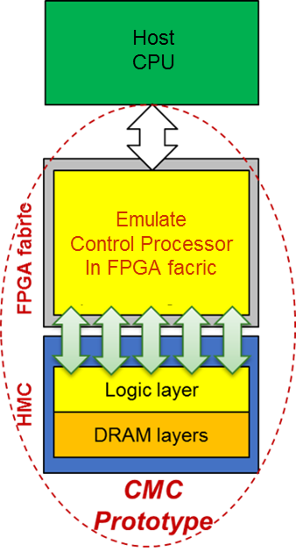
P3: Custom Memory Cube (CMC)
F3
Goal
Create flexible research platform for design space exploration of CMC apps & arch before existence of CMC
Motivation
Memory-intensive Big Data apps: memory bottleneck & high energy consumption
HMC: higher B/W & lower power than conventional memories
Potential for C-RAM* & PIM** processing (CMC)
Approach
Explore performance measurement methods for CMC platform
Research performance modelling for notional CMC architecture
Initial case study CMC app: DRE*** of LLNL
*C-RAM: Computational RAM
**PIM: Processor In Memory
⁺DRE: Data Reordering/Rearrangement Engine
From LLNL (Lawrence Livermore National Lab)

Slide 2
P3: Custom Memory Cube (CMC)
F3
Achievement
Initial prototype of CMC research platform on Convey Merlin* board (FPGA + HMC)
Merlin board
Model of notional CMC
Explore perf. measurement methods for CMC platform
Add hardware monitors to infrastructure Verilog code to count latency
Research perf. modelling for notional CMC architecture
*Merlin board from Convey Computer, Inc. (now part of Micron)
Nair, R., et al. "Active Memory Cube: A processing-in-memory architecture for exascale systems.“
IBM Journal of Research and Development 59.2/3 (2015): 17-1.

Slide 3
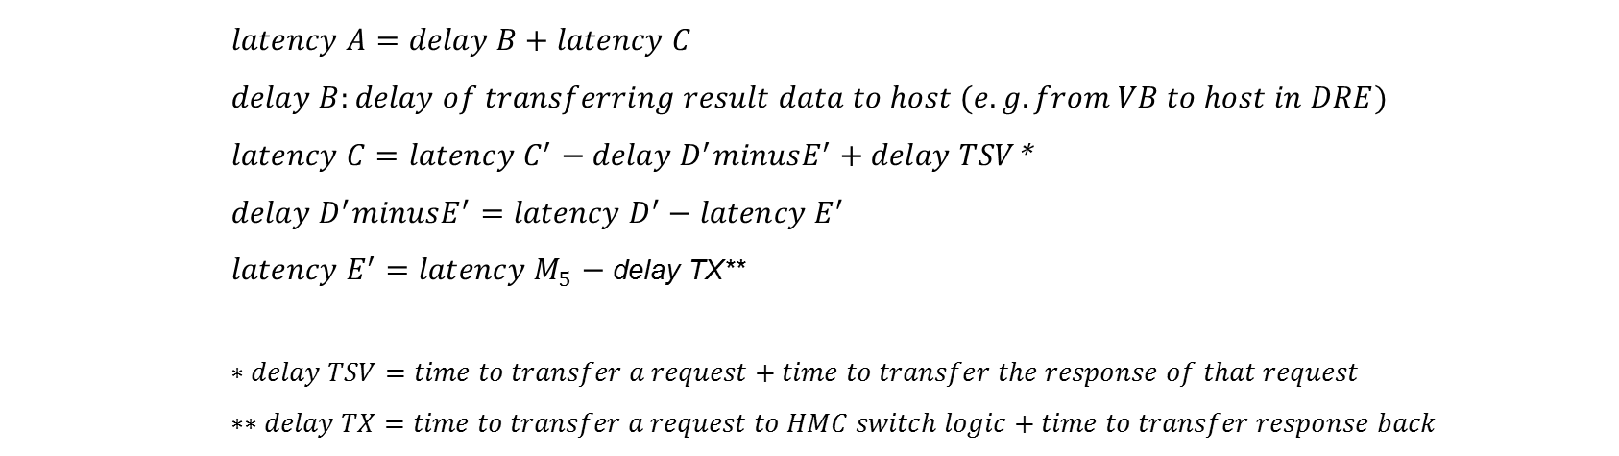
P3: Custom Memory Cube (CMC)
F3
$latency A=delay B+latency C$
$$delay B:delay of transferring result data to host (e.g. from VB to host in DRE)$$
$latency C=latency C^{′}−delay D^{′}minusE^{′}+delay TSV$*
$$delay D^{′}minusE^{′}=latency D^{′}−latency E^{′}$$
$latency E^{′}=latency M_{5}−$ delay TX**
$$∗delay TSV=time to transfer a request+time to transfer the response of that request$$
$$∗∗delay TX=time to transfer a request to HMC switch logic+time to transfer response back$$
*Merlin board from Convey Computer, Inc. (now part of Micron)
Nair, R., et al. "Active Memory Cube: A processing-in-memory architecture for exascale systems.“
IBM Journal of Research and Development 59.2/3 (2015): 17-1.

Slide 4
P3: Custom Memory Cube (CMC)
F3
Perf. modelling of notional CMC architecture
Case study: Data Reordering/Rearrangement Engine
Achievements
Placeholder 1
Placeholder 2
Placeholder 3
Performance of single memory operations (wr/rd)
Performance of DRE operations
Performance of DRE applications: SpMV

